Slide 1

Chapter 4 – Requirements Engineering
Chapter 4 Requirements engineering

Slide 2
Topics covered
Functional and non-functional requirements
The software requirements document
Requirements specification
Requirements engineering processes
Requirements elicitation and analysis
Requirements validation
Requirements management
Chapter 4 Requirements engineering

Slide 3
Requirements engineering
The process of establishing the services that the customer requires from a system and the constraints under which it operates and is developed.
The requirements themselves are the descriptions of the system services and constraints that are generated during the requirements engineering process.
Chapter 4 Requirements engineering

Slide 4
What is a requirement?
It may range from a high-level abstract statement of a service or of a system constraint to a detailed mathematical functional specification.
This is inevitable as requirements may serve a dual function
May be the basis for a bid for a contract - therefore must be open to interpretation;
May be the basis for the contract itself - therefore must be defined in detail;
Both these statements may be called requirements.
Chapter 4 Requirements engineering

Slide 5
Requirements abstraction (Davis)
“If a company wishes to let a contract for a large software development project, it must define its needs in a sufficiently abstract way that a solution is not pre-defined. The requirements must be written so that several contractors can bid for the contract, offering, perhaps, different ways of meeting the client organization’s needs. Once a contract has been awarded, the contractor must write a system definition for the client in more detail so that the client understands and can validate what the software will do. Both of these documents may be called the requirements document for the system.”
Chapter 4 Requirements engineering

Slide 6
Types of requirement
User requirements
Statements in natural language plus diagrams of the services the system provides and its operational constraints. Written for customers.
System requirements
A structured document setting out detailed descriptions of the system’s functions, services and operational constraints. Defines what should be implemented so may be part of a contract between client and contractor.
Chapter 4 Requirements engineering

Slide 7
User and system requirements
Chapter 4 Requirements engineering

Slide 8
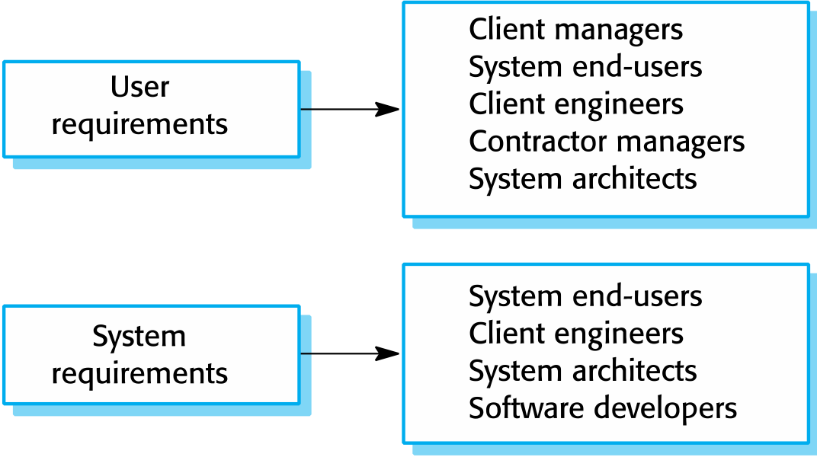
Readers of different types of requirements specification
Chapter 4 Requirements engineering

Slide 9
Functional and non-functional requirements
Functional requirements
Statements of services the system should provide, how the system should react to particular inputs and how the system should behave in particular situations.
May state what the system should not do.
Non-functional requirements
Constraints on the services or functions offered by the system such as timing constraints, constraints on the development process, standards, etc.
Often apply to the system as a whole rather than individual features or services.
Domain requirements
Constraints on the system from the domain of operation
Chapter 4 Requirements engineering

Slide 10
Functional requirements
Describe functionality or system services.
Depend on the type of software, expected users and the type of system where the software is used.
Functional user requirements may be high-level statements of what the system should do.
Functional system requirements should describe the system services in detail.
Chapter 4 Requirements engineering

Slide 11
Functional requirements for the MHC-PMS
A user shall be able to search the appointments lists for all clinics.
The system shall generate each day, for each clinic, a list of patients who are expected to attend appointments that day.
Each staff member using the system shall be uniquely identified by his or her 8-digit employee number.
Chapter 4 Requirements engineering

Slide 12
Requirements imprecision
Problems arise when requirements are not precisely stated.
Ambiguous requirements may be interpreted in different ways by developers and users.
Consider the term ‘search’ in requirement 1
User intention – search for a patient name across all appointments in all clinics;
Developer interpretation – search for a patient name in an individual clinic. User chooses clinic then search.
Chapter 4 Requirements engineering

Slide 13
Requirements completeness and consistency
In principle, requirements should be both complete and consistent.
Complete
They should include descriptions of all facilities required.
Consistent
There should be no conflicts or contradictions in the descriptions of the system facilities.
In practice, it is impossible to produce a complete and consistent requirements document.
Chapter 4 Requirements engineering

Slide 14
Non-functional requirements
These define system properties and constraints e.g. reliability, response time and storage requirements. Constraints are I/O device capability, system representations, etc.
Process requirements may also be specified mandating a particular IDE, programming language or development method.
Non-functional requirements may be more critical than functional requirements. If these are not met, the system may be useless.
Chapter 4 Requirements engineering

Slide 15
Types of nonfunctional requirement
Chapter 4 Requirements engineering

Slide 16
Non-functional requirements implementation
Non-functional requirements may affect the overall architecture of a system rather than the individual components.
For example, to ensure that performance requirements are met, you may have to organize the system to minimize communications between components.
A single non-functional requirement, such as a security requirement, may generate a number of related functional requirements that define system services that are required.
It may also generate requirements that restrict existing requirements.
Chapter 4 Requirements engineering

Slide 17
Non-functional classifications
Product requirements
Requirements which specify that the delivered product must behave in a particular way e.g. execution speed, reliability, etc.
Organisational requirements
Requirements which are a consequence of organisational policies and procedures e.g. process standards used, implementation requirements, etc.
External requirements
Requirements which arise from factors which are external to the system and its development process e.g. interoperability requirements, legislative requirements, etc.
Chapter 4 Requirements engineering

Slide 18
Examples of nonfunctional requirements in the MHC-PMS
Product requirement The MHC-PMS shall be available to all clinics during normal working hours (Mon–Fri, 0830–17.30). Downtime within normal working hours shall not exceed five seconds in any one day. Organizational requirement Users of the MHC-PMS system shall authenticate themselves using their health authority identity card. External requirement The system shall implement patient privacy provisions as set out in HStan-03-2006-priv.
Chapter 4 Requirements engineering

Slide 19
Goals and requirements
Non-functional requirements may be very difficult to state precisely and imprecise requirements may be difficult to verify.
Goal
A general intention of the user such as ease of use.
Verifiable non-functional requirement
A statement using some measure that can be objectively tested.
Goals are helpful to developers as they convey the intentions of the system users.
Chapter 4 Requirements engineering

Slide 20
Usability requirements
The system should be easy to use by medical staff and should be organized in such a way that user errors are minimized. (Goal)
Medical staff shall be able to use all the system functions after four hours of training. After this training, the average number of errors made by experienced users shall not exceed two per hour of system use. (Testable non-functional requirement)
Chapter 4 Requirements engineering

Slide 21
Metrics for specifying nonfunctional requirements
Property | Measure
Speed | Processed transactions/second User/event response time Screen refresh time
Size | Mbytes Number of ROM chips
Ease of use | Training time Number of help frames
Reliability | Mean time to failure Probability of unavailability Rate of failure occurrence Availability
Robustness | Time to restart after failure Percentage of events causing failure Probability of data corruption on failure
Portability | Percentage of target dependent statements Number of target systems
Chapter 4 Requirements engineering

Slide 22
Requirements engineering processes
The processes used for RE vary widely depending on the application domain, the people involved and the organisation developing the requirements.
However, there are a number of generic activities common to all processes
Requirements elicitation;
Requirements analysis;
Requirements validation;
Requirements management.
In practice, RE is an iterative activity in which these processes are interleaved.
Chapter 4 Requirements engineering

Slide 23
A spiral view of the requirements engineering process
Chapter 4 Requirements engineering

Slide 24
Requirements elicitation and analysis
Sometimes called requirements elicitation or requirements discovery.
Involves technical staff working with customers to find out about the application domain, the services that the system should provide and the system’s operational constraints.
May involve end-users, managers, engineers involved in maintenance, domain experts, trade unions, etc. These are called stakeholders.
Chapter 4 Requirements engineering

Slide 25
Problems of requirements analysis
Stakeholders don’t know what they really want.
Stakeholders express requirements in their own terms.
Different stakeholders may have conflicting requirements.
Organisational and political factors may influence the system requirements.
The requirements change during the analysis process. New stakeholders may emerge and the business environment may change.
Chapter 4 Requirements engineering

Slide 26
Requirements elicitation and analysis
Software engineers work with a range of system stakeholders to find out about the application domain, the services that the system should provide, the required system performance, hardware constraints, other systems, etc.
Stages include:
Requirements discovery,
Requirements classification and organization,
Requirements prioritization and negotiation,
Requirements specification.
Chapter 4 Requirements engineering

Slide 27
The requirements elicitation and analysis process
Chapter 4 Requirements engineering

Slide 28
Process activities
Requirements discovery
Interacting with stakeholders to discover their requirements. Domain requirements are also discovered at this stage.
Requirements classification and organisation
Groups related requirements and organises them into coherent clusters.
Prioritisation and negotiation
Prioritising requirements and resolving requirements conflicts.
Requirements specification
Requirements are documented and input into the next round of the spiral.

Slide 29
Requirements discovery
The process of gathering information about the required and existing systems and distilling the user and system requirements from this information.
Interaction is with system stakeholders from managers to external regulators.
Systems normally have a range of stakeholders.
Chapter 4 Requirements engineering
Notes:
Distilling:提取

Slide 30
Stakeholders in the MHC-PMS
Patients whose information is recorded in the system.
Doctors who are responsible for assessing and treating patients.
Nurses who coordinate the consultations with doctors and administer some treatments.
Medical receptionists who manage patients’ appointments.
IT staff who are responsible for installing and maintaining the system.
Chapter 4 Requirements engineering

Slide 31
Stakeholders in the MHC-PMS
A medical ethics manager who must ensure that the system meets current ethical guidelines for patient care.
Health care managers who obtain management information from the system.
Medical records staff who are responsible for ensuring that system information can be maintained and preserved, and that record keeping procedures have been properly implemented.
Chapter 4 Requirements engineering

Slide 32
Interviewing
Formal or informal interviews with stakeholders are part of most RE processes.
Types of interview
Closed interviews based on pre-determined list of questions
Open interviews where various issues are explored with stakeholders.
Effective interviewing
Be open-minded, avoid pre-conceived ideas about the requirements and are willing to listen to stakeholders.
Prompt the interviewee to get discussions going using a springboard question, a requirements proposal, or by working together on a prototype system.
Chapter 4 Requirements engineering

Slide 33
Interviews in practice
Normally a mix of closed and open-ended interviewing.
Interviews are good for getting an overall understanding of what stakeholders do and how they might interact with the system.
Interviews are not good for understanding domain requirements
Requirements engineers cannot understand specific domain terminology;
Some domain knowledge is so familiar that people find it hard to articulate or think that it isn’t worth articulating.

Slide 34
Ethnography
A social scientist spends a considerable time observing and analysing how people actually work.
People do not have to explain or articulate their work.
Social and organisational factors of importance may be observed.
Ethnographic studies have shown that work is usually richer and more complex than suggested by simple system models.
Chapter 4 Requirements engineering

Slide 35
Scope of ethnography
Requirements that are derived from the way that people actually work rather than the way I which process definitions suggest that they ought to work.
Requirements that are derived from cooperation and awareness of other people’s activities.
Awareness of what other people are doing leads to changes in the ways in which we do things.
Ethnography is effective for understanding existing processes but cannot identify new features that should be added to a system.
Chapter 4 Requirements engineering

Slide 36
Focused ethnography
Developed in a project studying the air traffic control process
Combines ethnography with prototyping
Prototype development results in unanswered questions which focus the ethnographic analysis.
The problem with ethnography is that it studies existing practices which may have some historical basis which is no longer relevant.
Chapter 4 Requirements engineering

Slide 37
Ethnography and prototyping for requirements analysis
Chapter 4 Requirements engineering
Notes:
Debrief：情况汇报

